Slide 1
Calculo Numérico I Raíces de ecuaciones: Métodos Abiertos - I
Dr. Luis Sanchez

Slide 2
Objectives
Understanding the fixed-point iteration method and how you can evaluate its convergence characteristics.
Knowing how to solve a roots problem with the Newton-Raphson method.

Slide 3
Open Methods
Open methods differ from bracketing methods, in that open methods require only a single starting value or two starting values that do not necessarily bracket a root.
Open methods may diverge as the computation progresses, but when they do converge, they usually do so much faster than bracketing methods.

Slide 4
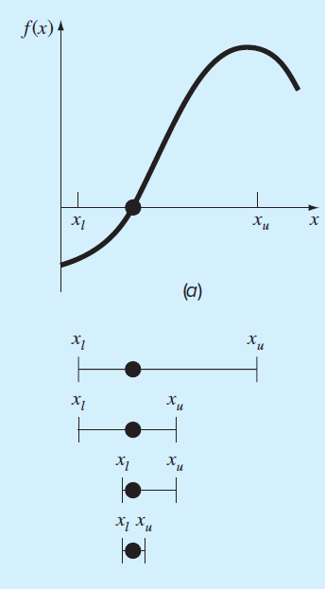
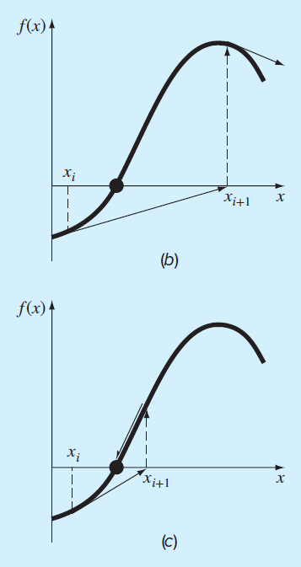
Graphical Comparison of Methods
Bracketing method
Diverging open method
Converging open method - note speed!

Slide 5
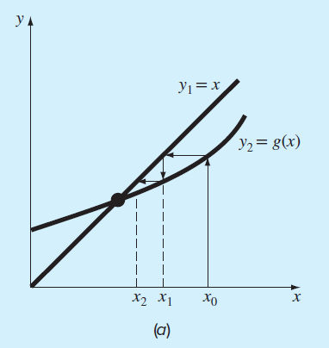
1. Simple Fixed-Point Iteration
Rearrange the function f(x)=0 so that x is on the left-hand side of the equation: x=g(x)
Use the new function g to predict a new value of x - that is, x_{i+1}=g(x_{i})
The approximate error is given by:

Slide 6
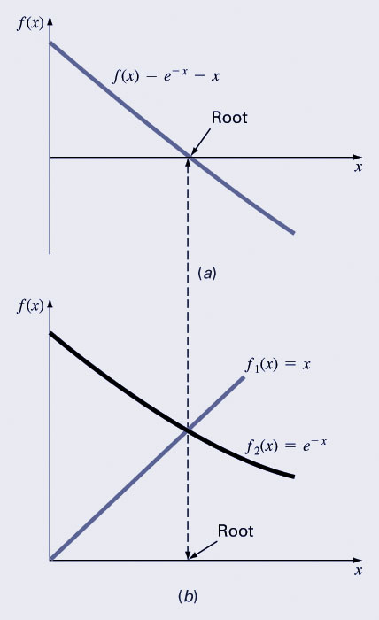
Example 01
Solve f(x)=e^{-x}-x
Re-write as x=g(x) by isolating x (example: x=e^{-x})
Start with an initial guess (here, 0)
Continue until some tolerance is reached
I | x_{i} | |ε_{a}| % | |ε_{t}| % | |ε_{t}|_{i}/|ε_{t}|_{i-1}
0 | 0.0000 |  | 100.000
1 | 1.0000 | 100.000 | 76.322 | 0.763
2 | 0.3679 | 171.828 | 35.135 | 0.460
3 | 0.6922 | 46.854 | 22.050 | 0.628
4 | 0.5005 | 38.309 | 11.755 | 0.533
the true value of the root: 0.56714329

Slide 7
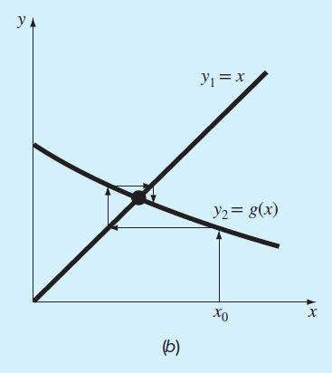
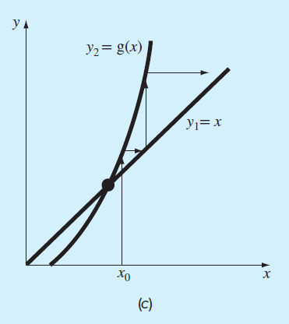
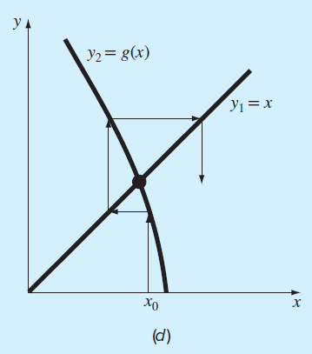
Convergence
Convergence of the simple fixed-point iteration method requires that the derivative of g(x) near the root has a magnitude less than 1.
Convergent, 0≤g’<1
Convergent, -1<g’≤0
Divergent, g’>1
Divergent, g’<-1

Slide 8
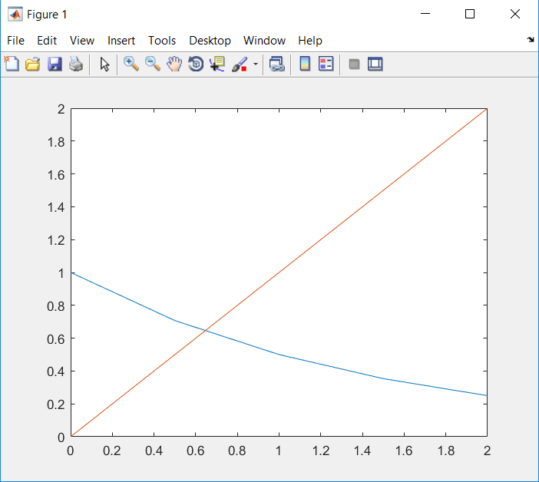
Example 02
Find the roots of f(x) = x - 2^(-x) = 0 using the fixed-point method implemented in Matlab.

Slide 9
2. Newton-Raphson Method (Also known as Newton’s Method)
Given an initial guess of the root x₀, Newton-Raphson method uses information about the function and its derivative at that point to find a better guess of the root.
Assumptions:
f(x) is continuous and the first derivative is known
An initial guess x₀ such that f’(x₀)≠0 is given

Slide 10
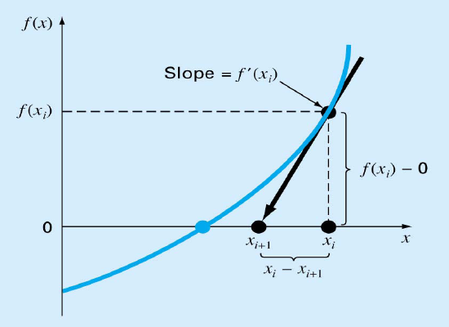
Newton Raphson Method - Graphical Depiction -
If the initial guess at the root is x_{i}, then a tangent to the function of x_{i} that is f’(x_{i}) is extrapolated down to the x-axis to provide an estimate of the root at x_{i+1}.

Slide 11
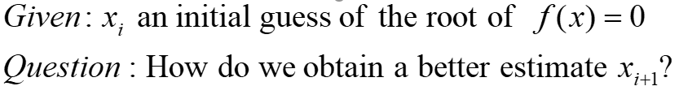
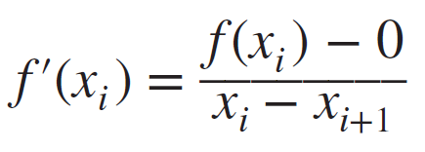
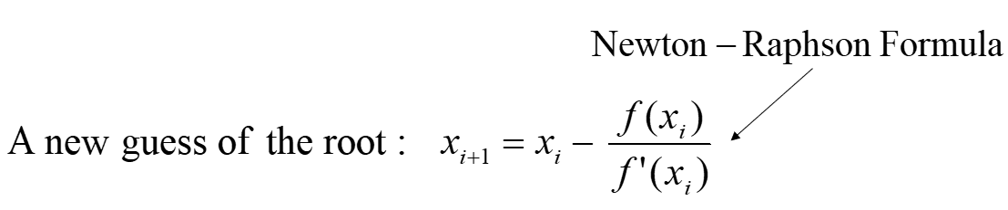
Derivation of Newton’s Method
The Newton-Raphson method can be derived on the basis of this geometrical interpretation. As the first derivative at x is equivalent to the slope:

Slide 12
Newton’s Method

Slide 13
Example

Slide 14
Example
k (Iteration) | x_{k} | f(x_{k}) | f’(x_{k}) | x_{k+1} | |x_{k+1} –x_{k}|
0 | 4 | 33 | 33 | 3 | 1
1 | 3 | 9 | 16 | 2.4375 | 0.5625
2 | 2.4375 | 2.0369 | 9.0742 | 2.2130 | 0.2245
3 | 2.2130 | 0.2564 | 6.8404 | 2.1756 | 0.0384
4 | 2.1756 | 0.0065 | 6.4969 | 2.1746 | 0.0010

Slide 15


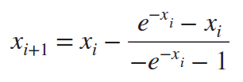
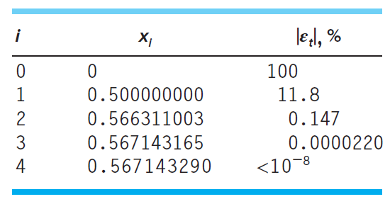
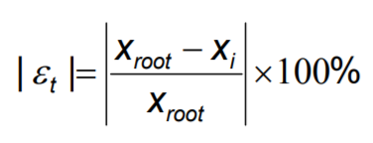
Use the Newton-Raphson method to estimate the root of
Example 02:
the true value of the root: 0.56714329

Slide 16
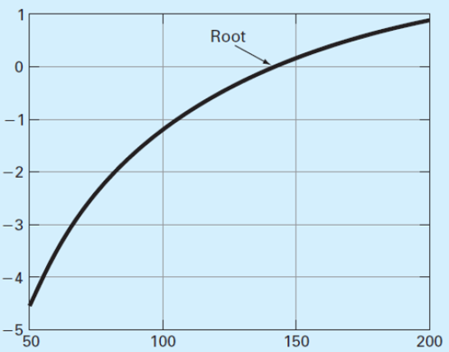
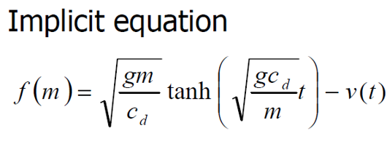
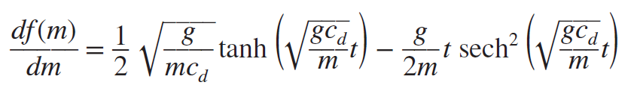
Example 03
Implement a .M file to use the Newthon-Raphson method to determine the mass of the bungee jumper with a drag coefficient of 0.25kg/m to have a velocity of 36m/s after 4 s of free fall. The acceleration of gravity is 9.81m/s².

Slide 17
Matlab Code for Newton Raphson Method
function [root,ea,iter] = newtraph(func,dfunc,xr,es,maxit,varargin)
% input:
% func = name of function
% dfunc = name of derivative of function
% xr = initial guess
% es = desired relative error (default = 0.0001%)
% maxit = maximum allowable iterations (default = 50)
% p1,p2,... = additional parameters used by function
% output:
% root = real root
% ea = approximate relative error (%)
% iter = number of iterations
if nargin<3
error('at least 3 input arguments required');
end
if nargin<4||isempty(es)
es=0.0001;
end
if nargin<5||isempty(maxit)
maxit = 50;
end
iter = 0;

Slide 18
while (1)
xrold = xr;
xr = xr-func(xr)/dfunc(xr);
iter = iter + 1;
if xr ~= 0
ea = abs((xr-xrold)/xr)*100;
end
if ea <= es | iter >= maxit,
break;
end
end
root = xr;
>> y = @(m) sqrt(9.81*m/0.25)*tanh(sqrt(9.81*0.25/m)*4)-36;
>> dy=@(m) 1/2*sqrt(9.81/(m*0.25))*tanh((9.81*0.25/m)^(1/2)*4)-9.81/(2*m)*sech(sqrt(9.81*0.25/m)*4)^2;
>> newtraph(y,dy,140,0.00001)

Slide 19
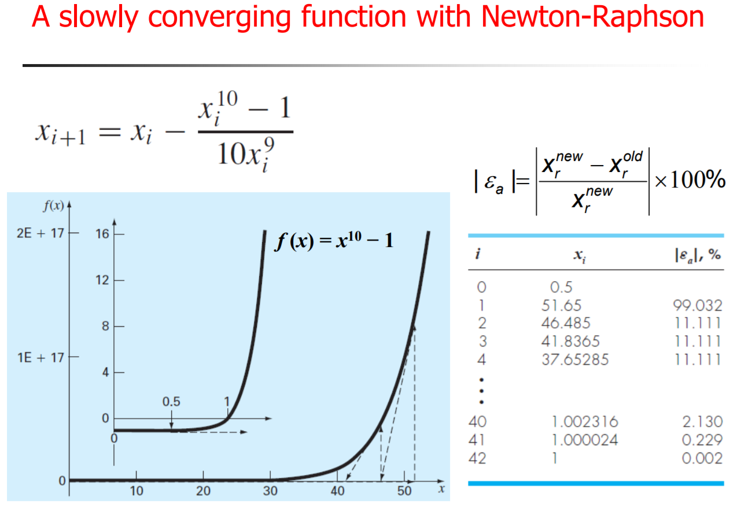
Drawbacks

Slide 20
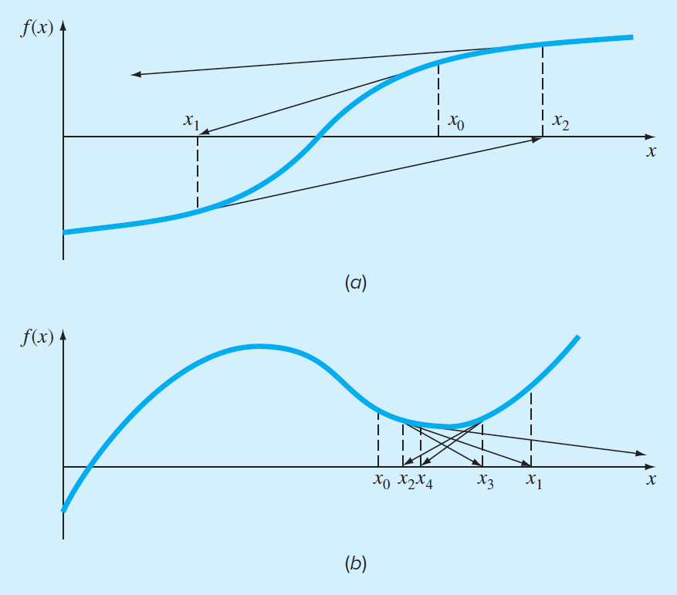
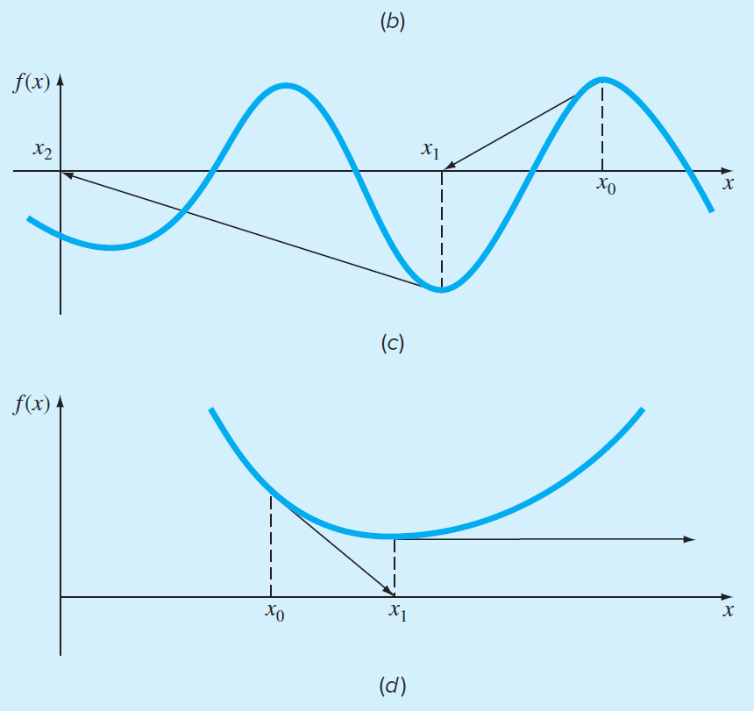
Four cases where the Newton-Raphson method exhibits poor convergence.
a) Inflection point ( f ″ (x) = 0) occurs in the vicinity of a root.
b) The Newton-Raphson technique to oscillate around a local maximum or minimum.
c) Initial guess that is close to one root can jump to a location several roots away.
d) Solution shoots off horizontally and never hits the x axis.

Slide 21
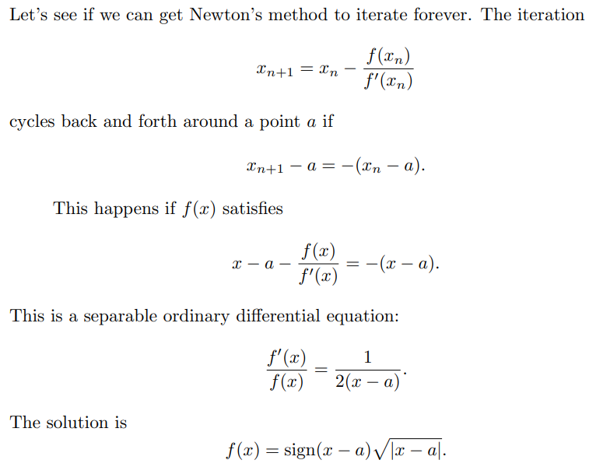
A Perverse Example
If we draw the tangent to the graph at any point, it intersects the x-axis on the opposite side of x = a. Newton’s method cycles forever, neither converging nor diverging.
>> ezplot('sign(x-2)*sqrt(abs(x-2))',0,4)
>> grid on

